Slide 1



Take Off!
Migration, Deployment, and Taking Flight
1

Slide 2


If you build it, they won’t just come
Integrated Marketing Communications Strategy
Internal Awareness, start early! Get buy in from the Communications team!
Coordinate efforts timing and cross promotion
Leverage every opportunity
2

Slide 3
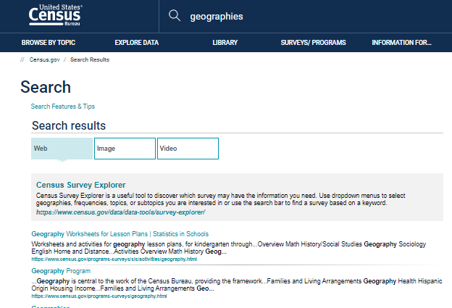
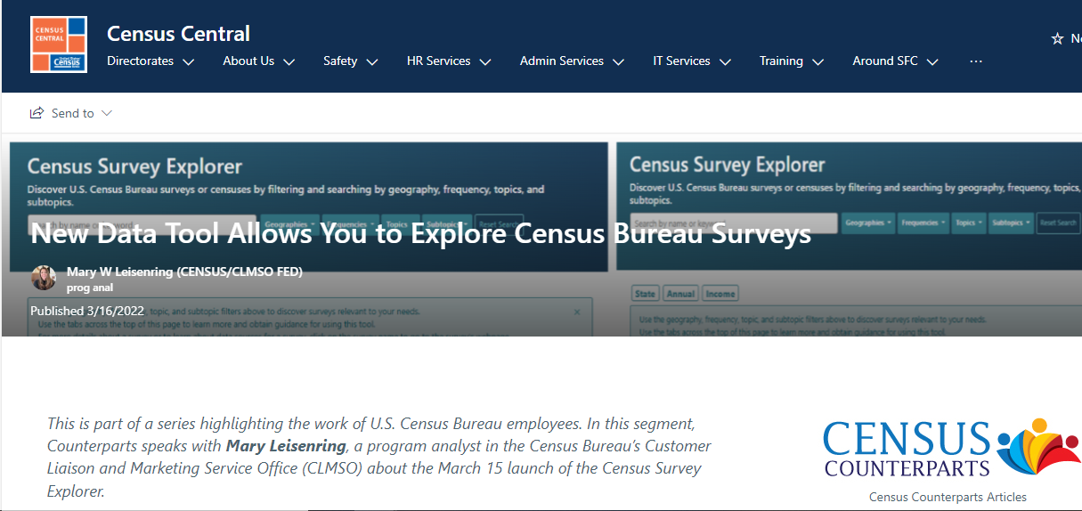

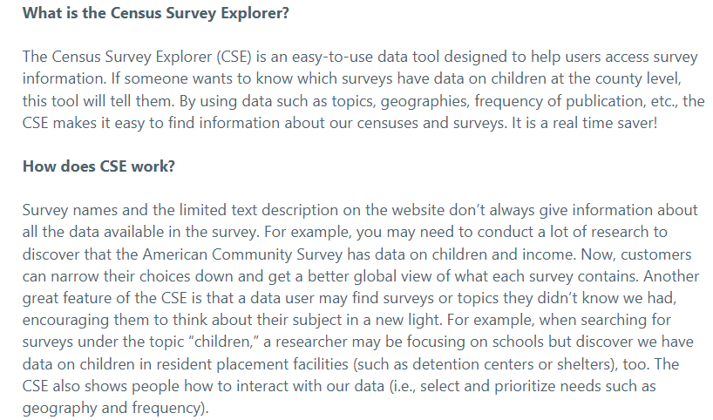
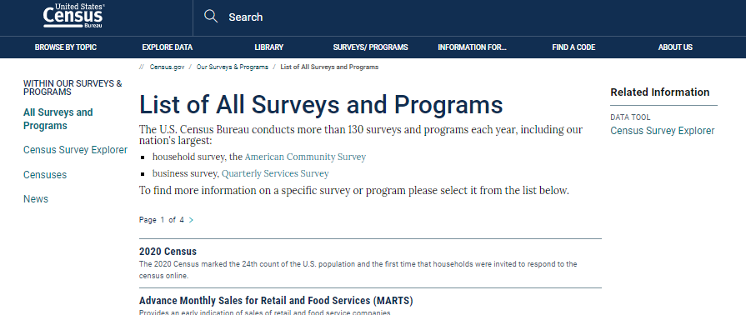
If you build it, they won’t just come
Integrated Marketing Communications Strategy
Internal Awareness, start early! Get buy in from the Communications team!
Coordinate efforts timing and cross promotion
Leverage every opportunity

Slide 4

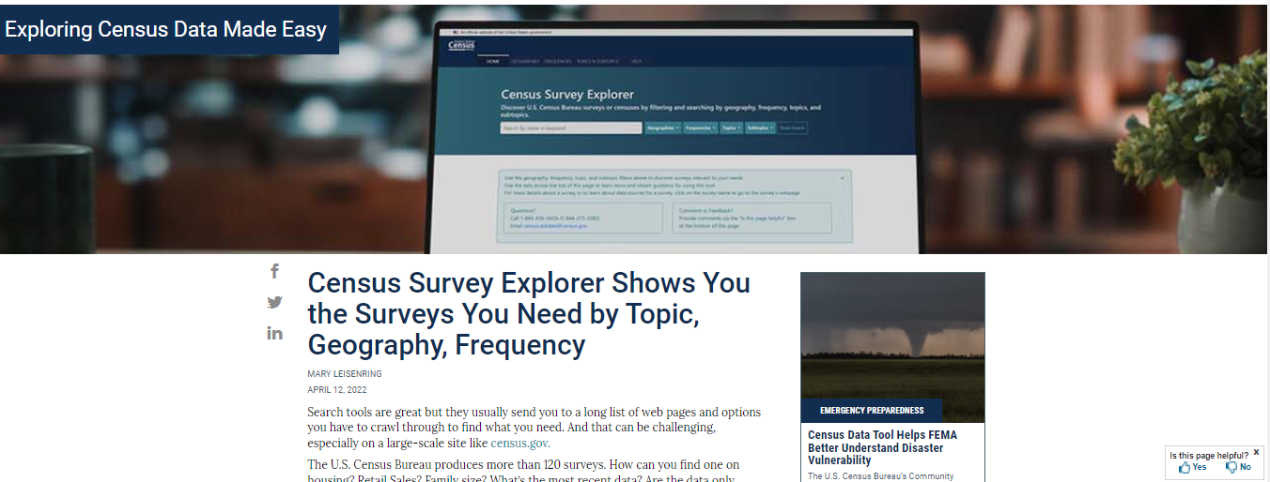

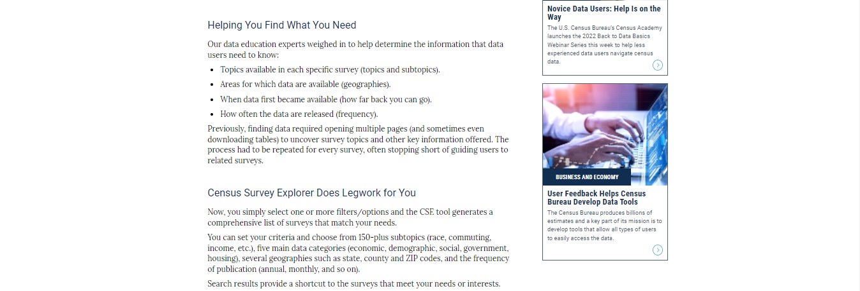
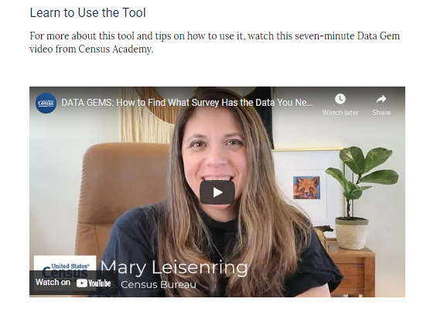
If you build it, they won’t just come
Integrated Marketing Communications Strategy
Internal Awareness, start early! Get buy in from the Communications team!
Coordinate efforts timing and cross promotion
Leverage every opportunity… for the long haul
4

Slide 5

If you build it, they won’t just come
Integrated Marketing Communications Strategy
Internal Awareness, start early! Get buy in from the Communications team!
Coordinate efforts timing and cross promotion
Leverage every opportunity… for the long haul
5

Slide 6


To Demo Census Survey Explorer:
https://census.gov/surveyexplorer
6

Slide 7
Questions?
Ask away!
7

Slide 8

Get in Touch with Us
Mary Lesienring
U.S. Census Bureau
Data Dissemination and Training Branch
mary.w.leisenring@census.gov
Eric Coyle
U.S. Census Bureau
Data Dissemination and Training Branch
eric.a.coyle@census.gov
Logan Powel
U.S. Census Bureau
Digital Marketing Team, CLMSO
logan.t.powel @census.gov
8

Slide 9


UI is the saddle, the stirrups and the reigns. UX is the feeling you get being able to ride the horse and rope the cattle. ~Dain Miller Thank You!
9

